Slide 1


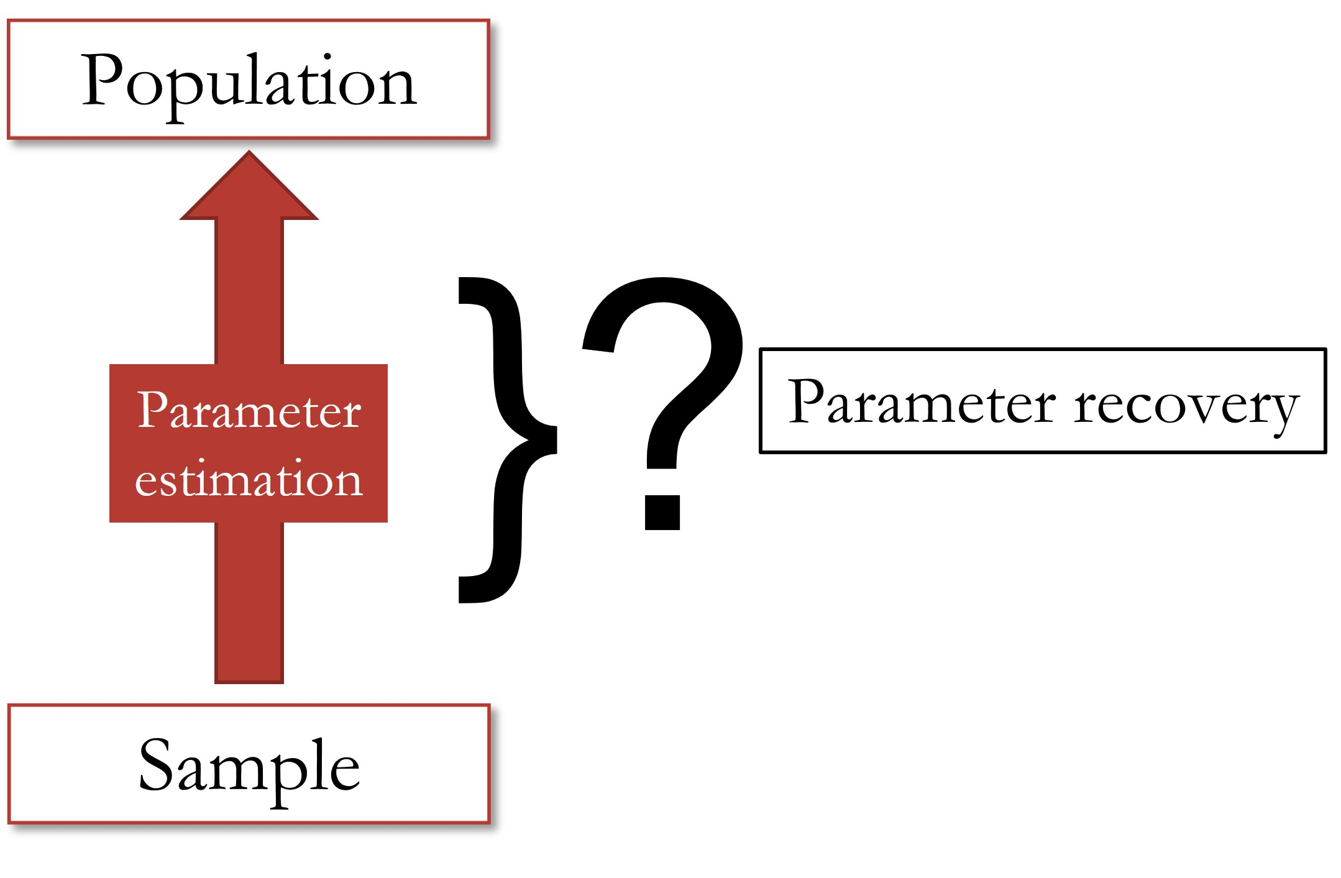
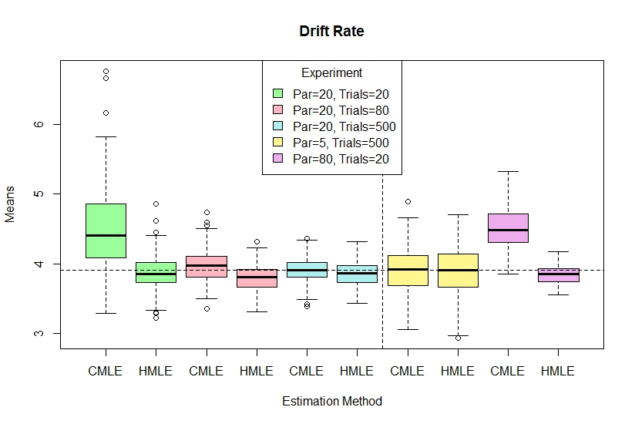
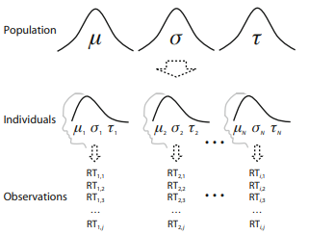
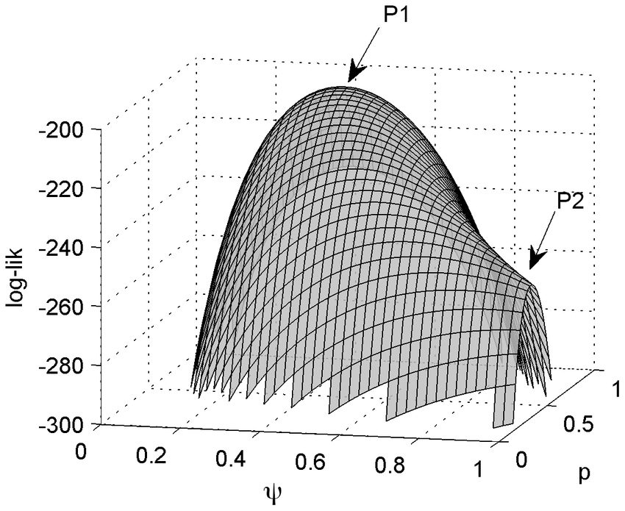
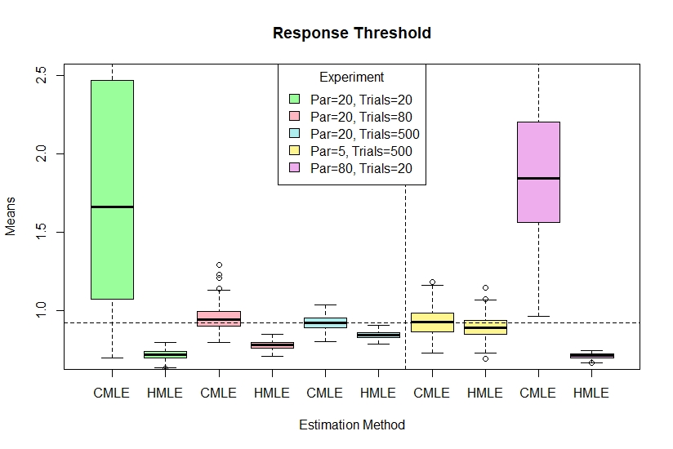
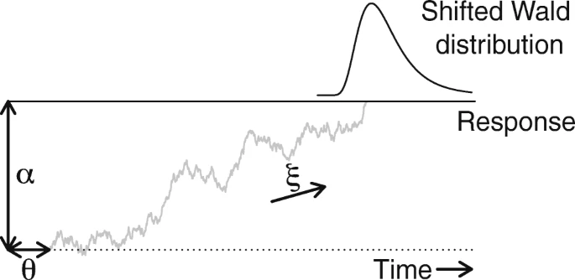
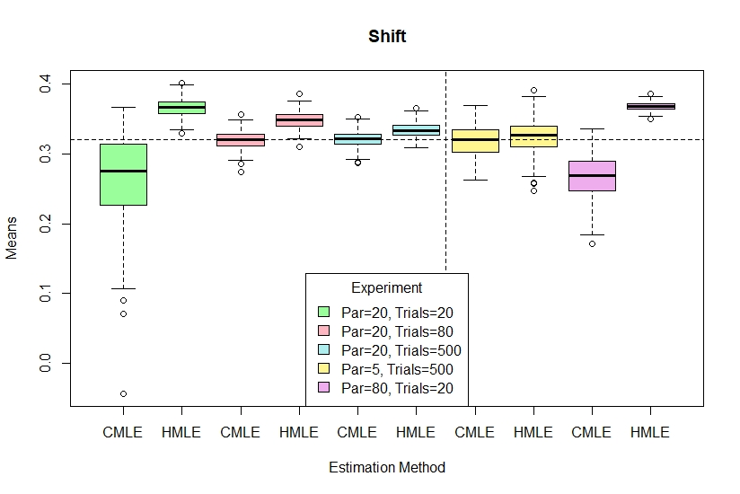
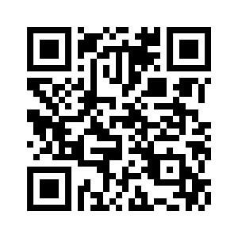
Evaluating Single-Level and Hierarchical Maximum Likelihood Estimation in Shifted-Wald Models
B.L. Scheuler¹², J.W. Houpt¹, and T.J. Faulkenberry²
¹The University of Texas at San Antonio, San Antonio TX, 78249 ²Tarleton State University, Stephenville TX, 76401
Parameter Recovery
Methods
Results: Error and Bias
Response times are a crucial component of understanding and measuring cognitive processes. By fitting a model to a distribution of observed response times, we can estimate population parameters that could have potentially generated the observed sample. But, how do we know that the estimated parameters are representative of the true population parameters? To assess the validity of our estimation techniques, we must conduct a parameter recovery study.
For this study, we simulated data using shifted-Wald parameter targets reported by Faulkenberry et al. (2018). This was composed of four main steps:
Generate 'artificial' people from parent population
Generate response times for artificial people
Fit shifted-Wald model to RT distribution with CMLE and HMLE
Compare estimates to original target parameters
This process was applied to 5 sub-experiments in a design used by Farrell and Ludwig (2008). These sub-experiments had 5, 20, or 80 participants, with 20, 80, or 500 trials per participant.
Results: Parameters
Estimation Methods
This study focused on two methods for estimating parameters:
Classical (single-level) maximum likelihood estimation (CMLE)
Hierarchical maximum likelihood estimation (HMLE)
Shifted-Wald Models
For this study we used a model of response times known as the shifted-Wald model, which is composed of three parameters:
Shift
Drift rate
Response threshold
There is a trade-off in estimation parameters
If a study is constrained to a smaller trial size, utilizing HMLE could ensure more accurate estimation
Discussion
There are still many questions left to be answered:
How would an alternative approach, (i.e., Bayesian) change our results?
Is there an optimum number of participants or trials?
How can we utilize these results to inform participant/ trial size decisions?
For references, R script, and more, please see QR code.

